Slide 1

boAt
Presented By:
Alisha Anand(02)
Chandni Goyal (05)
Priya Sharma(14)
Rasika Kumbhar(11)
Vithika Singh(20)

Slide 2
boAt
India’s No. 1 Earwear Audio Brand
Digital presence - Instagram, YouTube, Facebook, Linkedin and Twitter.
Own website: ‘boat-lifestyle’
Have a community called ‘boAthead’.
Integration with web channels like TVF and Filtercopy.
Unique selling proposition
Plug in earphones and get into peace with freedom.
Affordable, durable and fashionable product for millennials.
Take a boat, leave everything behind.

Slide 3
Website Traffic
Brands | Search as Traffic source | Referral sites | Global Alexa Rank | India Alexa Rank | Daily Page views per Visitor | Daily Time on Site | Bounce Rate
Boat-lifestyle | 50.3% | 79 | 18356 | 1278 | 2.68 | 3 min 1 sec | 41.3%
JBL | 71% | 1073 | 9727 | 2911 | 2.8 | 2 min 58 sec | 44%
Sony | 79% | 513 | 16044 | 1373 | 2.85 | 2 min 50 sec | 41.1%
Gonoise | 45% | 83 | 25315 | 1851 | 2.9 | 3 min 31 sec | 36.1%
Skullcandy | 71% | 70 | 100141 | 16380 | 4.4 | 5 min 15 sec | 26.1%
Bose | 69% | 2 | 147625 | 12929 | 3.1 | 2 min 42 sec | 34.6%

Slide 4
Social Media Numbers
Brands | Facebook likes | Facebook Followers | Instagram Followers | Instagram Posts | Twitter Followers | # Twitter
Boat-lifestyle | 1,180,572 | 1,185,058 | 367,000 | 1,323 | 9,091 | #PlugIntoNirvana
JBL | 3,194,919 | 3,198,855 | 479,000 | 1,737 | 173,400 | #DareToListen
Sony | 8,396,036 | 8,364,925 | 8,500,000 | 1,829 | 4,600,000 | NA
Gonoise | 658,817 | 665,564 | 279,000 | 1,500 | 7,794 | #TopOfTheGame
Skullcandy | 2,124,146 | 2,075,096 | 642,000 | 539 | 122,700 | #FeelCurious
Bose | 4,180,757 | 4,181,857 | 1,100,000 | 661 | 221,000 | #FeelItAll.

Slide 5
Customer Profile
Websites target customers visits
About Customers
1
Ecommerce Sites
Amazon
Flipkart
Myntra
15 to 45 years
Both Male and Female
Tier 1- Bangalore, Chennai, Delhi, Mumbai, hyderabad, Kolkata
Tier 2- Surat, Pune, Amritsar, Guwahati, Jamshedpur, Agra, Jodhpur
2
Social Media Sites
Facebook
Instagram
Youtube
3
OTT Platforms
Netflix
Prime Video
Hotstar
4
Applications
Gaming
Music
Food ordering
AGE
GENDER
LOCATION
5
Education Sites
Byju’s
Coursera
Pagalguy

Slide 6
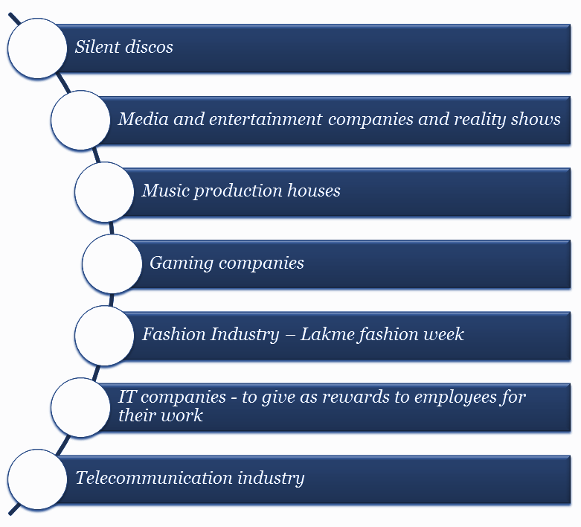
Profile of B2B customers

Slide 7
What is your Business Goal?
Sales
Numbers on Sales-
To become a Rs 500-crore consumer electronics company by 2022.
To sell 15,000-18,000 units per day.
Current Numbers on Sales-
Rs 100 crore in domestic sales alone.
Sells over 6,000 units per day with four units sold every minute(336 Million Units Per Year).

Slide 8
Brand building
Have fresh face campaign every 4 months
Strategize their content on the basis of trend keeping the platform in mind. As Instagram is more meme-centric and YouTube is more ad-centric.
Do brand shoot on topical content.
Communicate with their community,‘boAtheads’; More into acquiring sales hence focus more on engagement.
Planning to work on its own YouTube videos like unboxing.

Slide 9
Brand Acquisition & Sales
It has secured Rs 20 crore in venture debt from Flipkart Co-founder Sachin Bansal’s BAC Acquisitions. The startup said it will be using the funding for business operations.
Sales-1.They do 6000 to 8000 units of shipment per day
Have acquired over 1.2 Mn consumers

Slide 10
What will be your revenue models from Digital Platforms?
Revenue from CPM display
advertising on site
Revenue from CPC advertising on site
Online
Revenue Models
Subscriber data access for email marketing
Affiliate marketing (CPA but could be CPC)
Online ecommerce sales and transaction

Slide 11
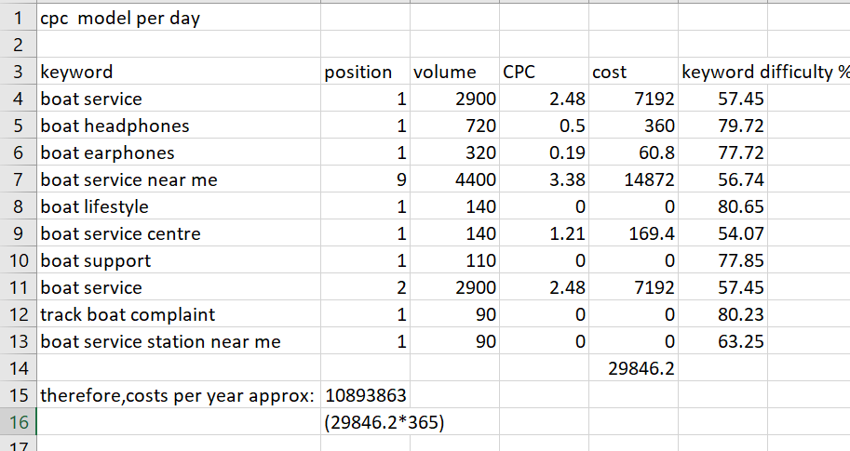
CPC Calculation
On a average, boAt sells around 7000 products aday..
80% of which come from online platforms
Amazon,flipkart,myntra,BoAt website
The rest 20% come from the physical stores
Croma,reliance digital,vijay sales

Slide 12
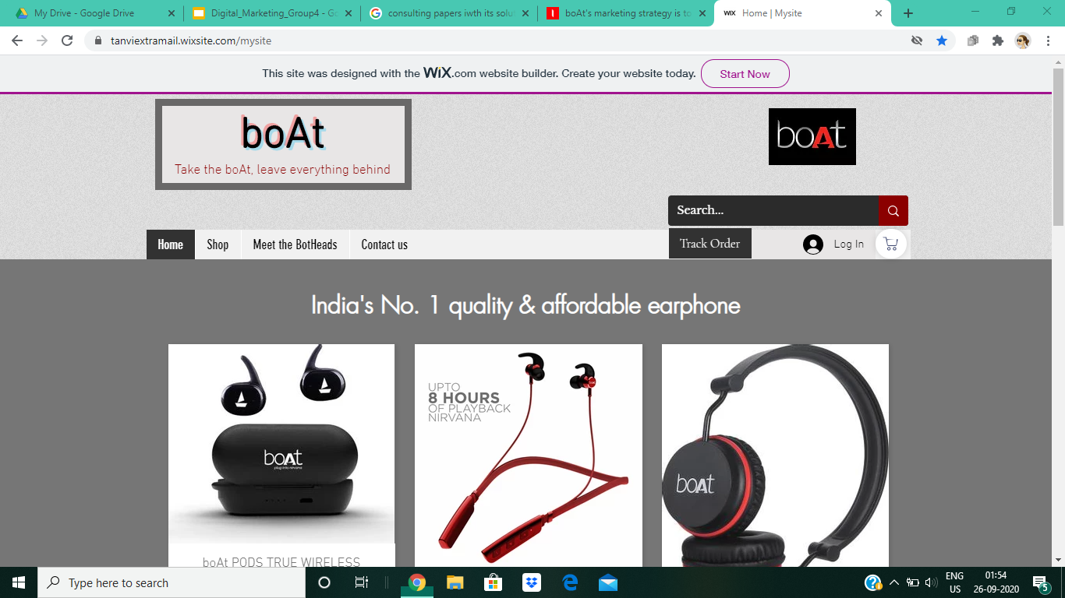
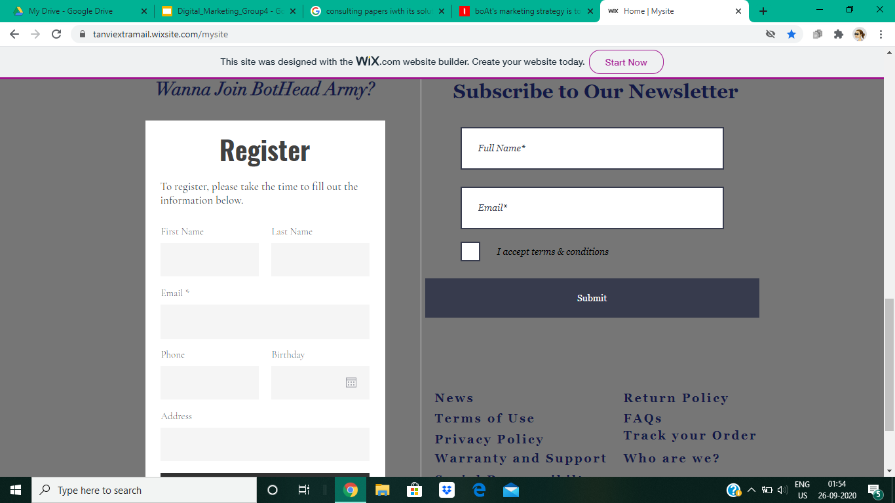
Website design
https://tanviextramail.wixsite.com/mysite
Variety of product display on homepage
Registration to become BoatHead.
Grey theme of the webpage

Slide 13
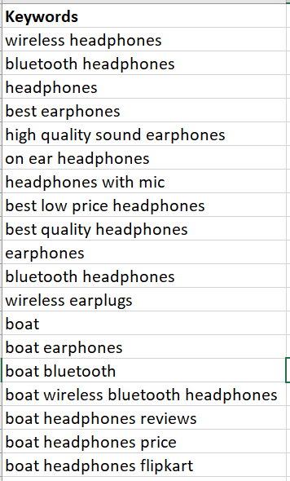
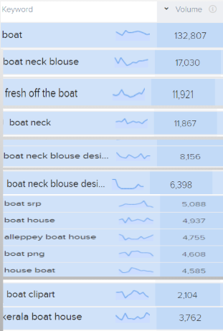
Which are the top 20 keywords necessary for SEO of your Business?
Negative Keywords

Slide 14
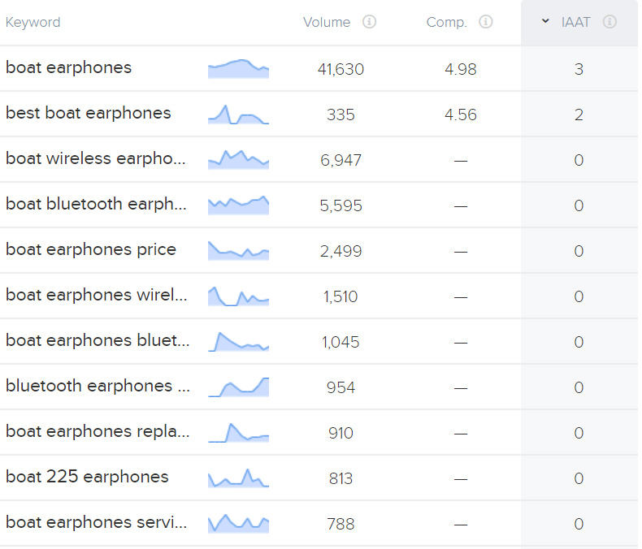
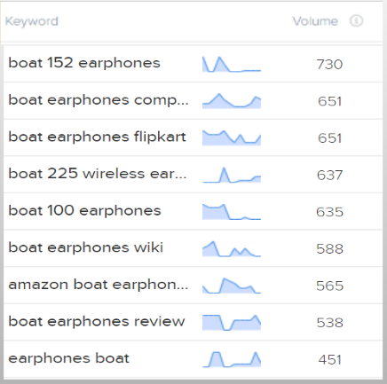
Which are the top 20 keywords necessary for SEO of your Business?

Slide 15
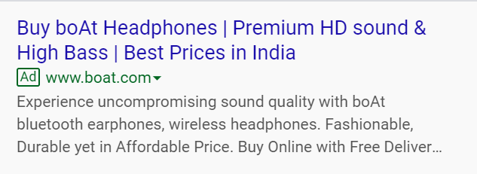
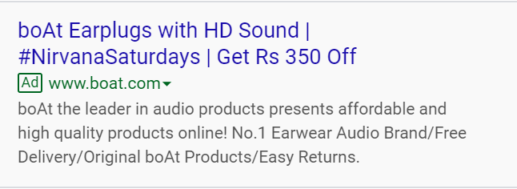
Google Ads
Headline 1 - Buy boAt Headphones
Headline 2 - Premium HD sound & High Bass
Headline 3 - Best Prices in India
Description 1 - Experience uncompromising sound quality with boAt bluetooth earphones, wireless headphones & more with latest designs.
Description 2 - Fashionable, Durable yet in Affordable Price. Buy Online with Free Delivery & Hassle Free Returns
Headline1-boAt Earplugs with HD Sound
Headline2-#NirvanaSaturdays
Headline 3-Get Rs 350 Off
Description 1-boAt the leader in audio products presents affordable and high quality products online!
Description 2-No.1 Earwear Audio Brand/Free Delivery/Original boAt Products/Easy Returns

Slide 16











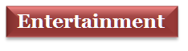




Websites/Applications to show banner ads and video pre rolls

Slide 17
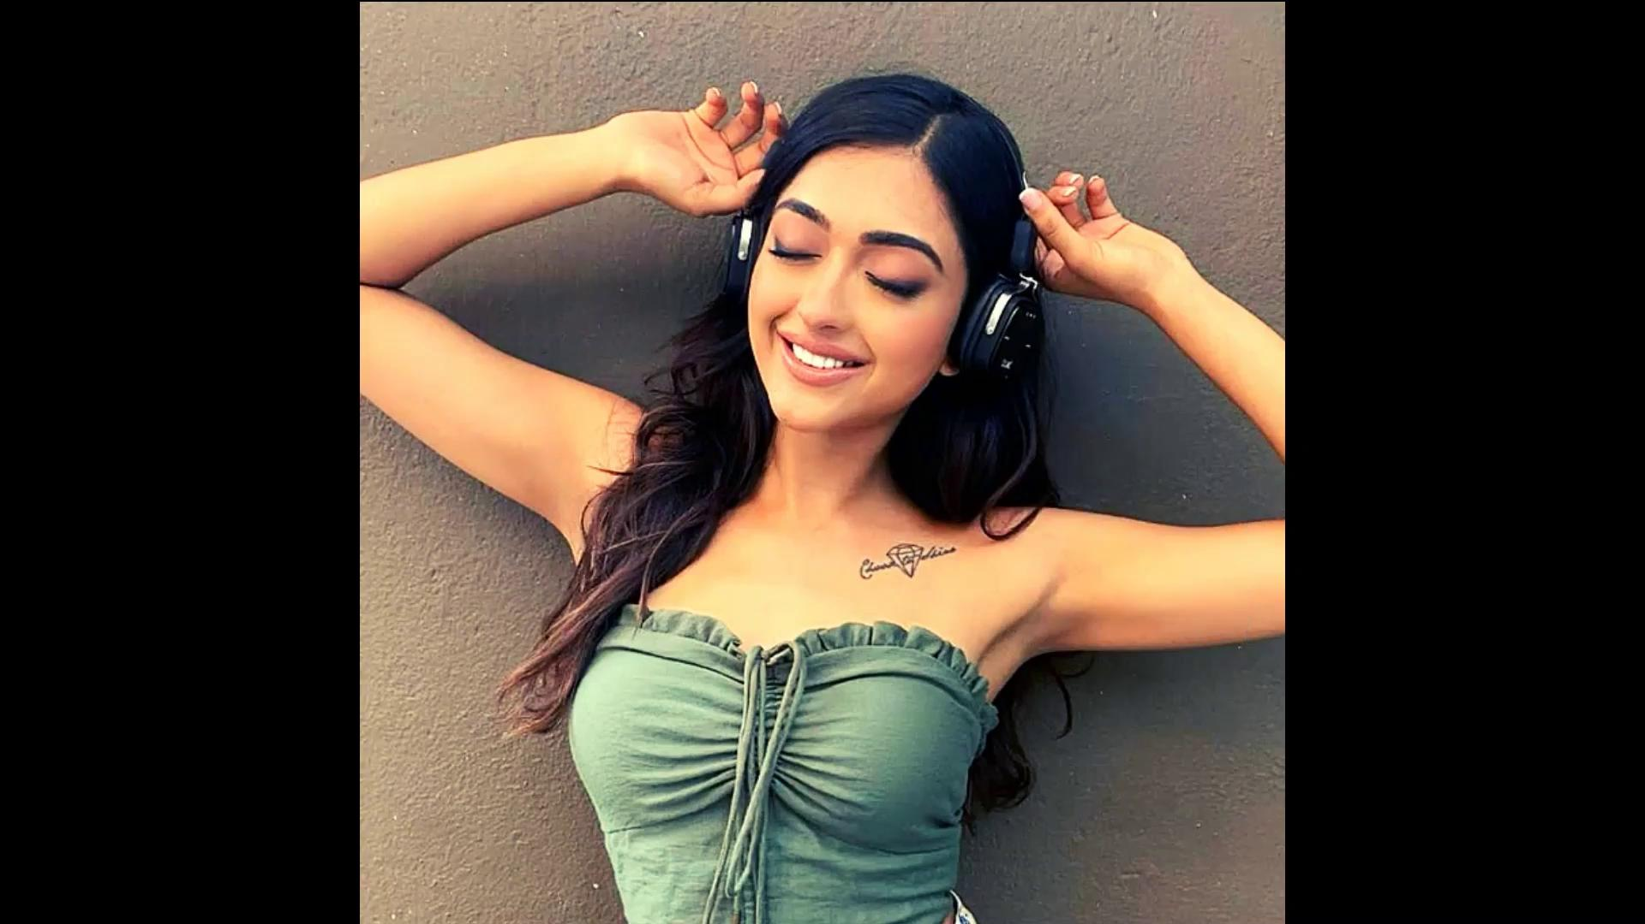
Posts to promote Brand/Product
The idea behind the ad is to promote wireless products of Boat.
Using a movie title “No Strings Attached”.

Slide 18
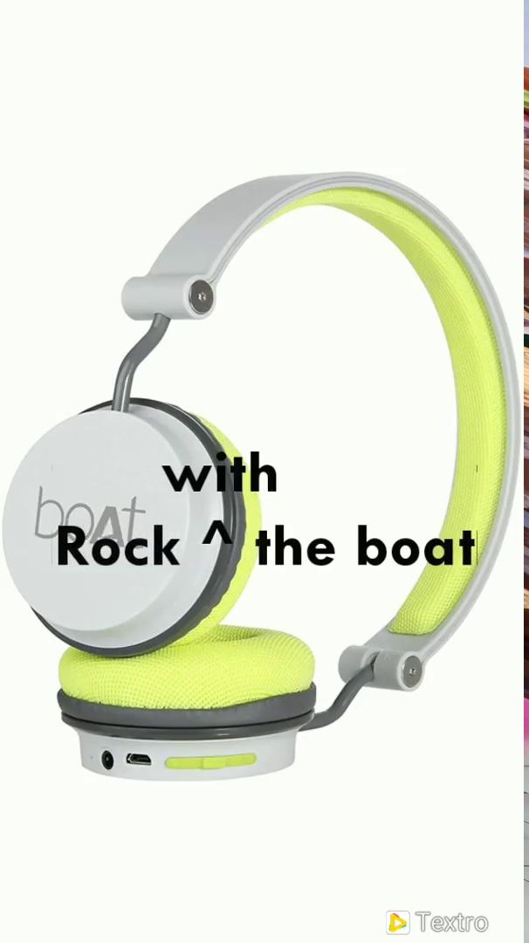
Posts to promote Brand/Product
The idea behind the ad is to promote boAt as Brand.
Over here we used a pun.
Rock the boat(it's a phrase): It means Causing problem.
We twisted the phrase by adding “WITH” in between
Message: Don’t Rock the boat,Instead Rock with the BOAT

Slide 19

Posts to promote Product
Idea behind the poster:
You can enjoy cooking,dinner and company of your partner and good Music will add more fun,more colours to your happy time.
boAt Stone 650 Portable Wireless Speaker will give you hassle free music experience with 10W Stereo Sound, Powerful Bass, IPX5 Water & Splash Resistance, Multiple Connectivity Modes and Up to 7H Playback

Slide 20
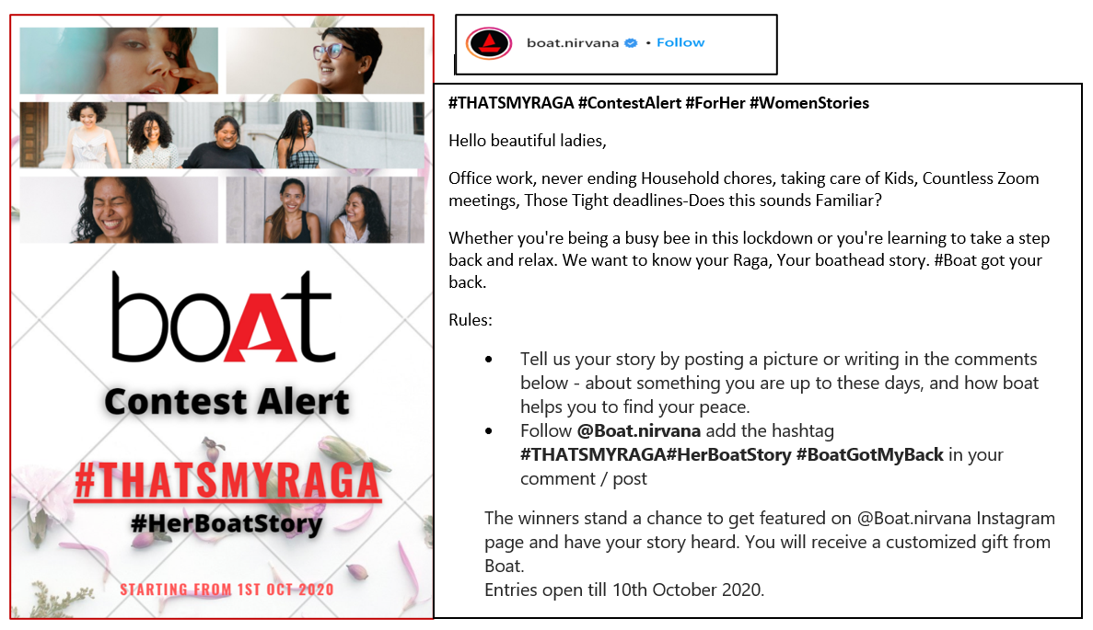
Social Media Campaign

Slide 21

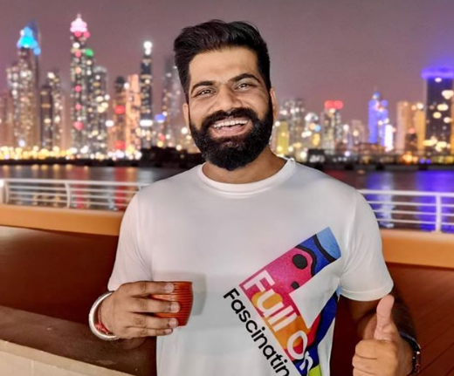
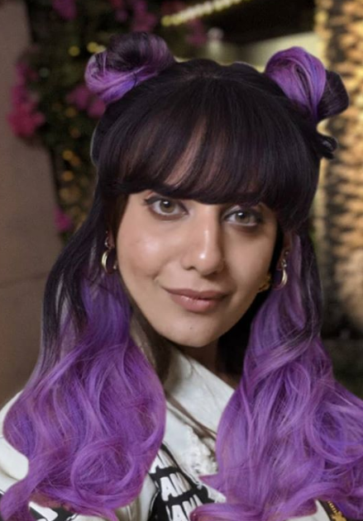
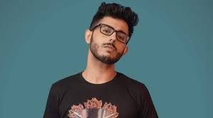
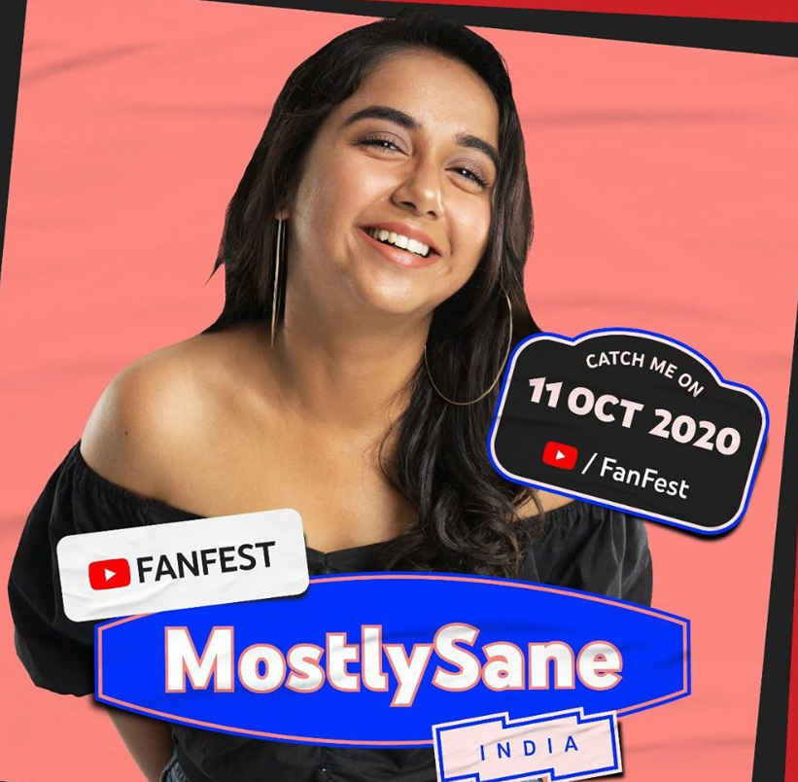
Influencers
Name: Prajakta Koli
Youtube Handle: Mostlysane
Content: Comedy
Subscribers: 5.71M
Name: Vidya Vox
Youtube Handle: VidyaVox
Content: Music
Subscribers: 7.05M
Name: Gaurav Chaudhary
Youtube Handle: TechnicalGuruji
Content: Gadget Reviews
Subscribers: 19.1M
Name: Kusha Kapila
Instagram Handle: Kusha Kapila
Content: Comedy
Followers:1.4M
Name: Ajay Nagar
Youtube Handle: carryminati
Content: comedic skits and reactions
Reviews
Subscribers: 25M

Slide 22
THANK YOU

